Slide 1


Clash of Classes
Vikings vs. Saxons: A Python Battle Royale
War Masters:
Natasha Silvestre
Mitesh Parab
Mohamad Traiki
Girish Kumar

Slide 2

Project Overview
The Battle Scenario
Vikings and Saxons clash in an epic war simulation. Both are soldiers with unique combat abilities, but each fights differently.
Our mission: Build a complete combat system using Python’s Inheritance model to bring this medieval battle to life.
Concepts
Creating base and derived classes
Using super() for inheritance
Method overriding techniques
Managing object collections
Random selection algorithms

Slide 3
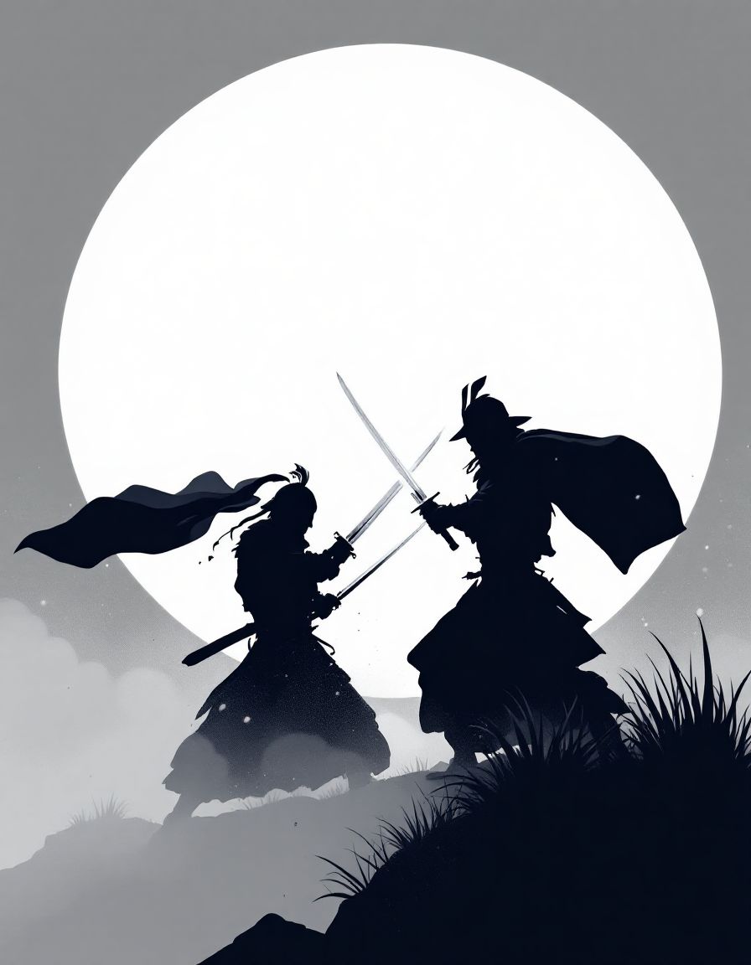
Building the Soldier Base Class
class Soldier:
def __init__(self, health, strength):
self.health = health
self.strength = strength
def attack(self):
return self.strength
def receiveDamage(self, damage):
self.health -= damage
Constructor
Initialize with health and strength properties to
track combat readiness and attach power.
attack() Method
Returns the soldier’s strength value, representing the damage dealt in combat.
receiveDamage() Method
Reduces health by the damage amount received. No return value needed.

Slide 4
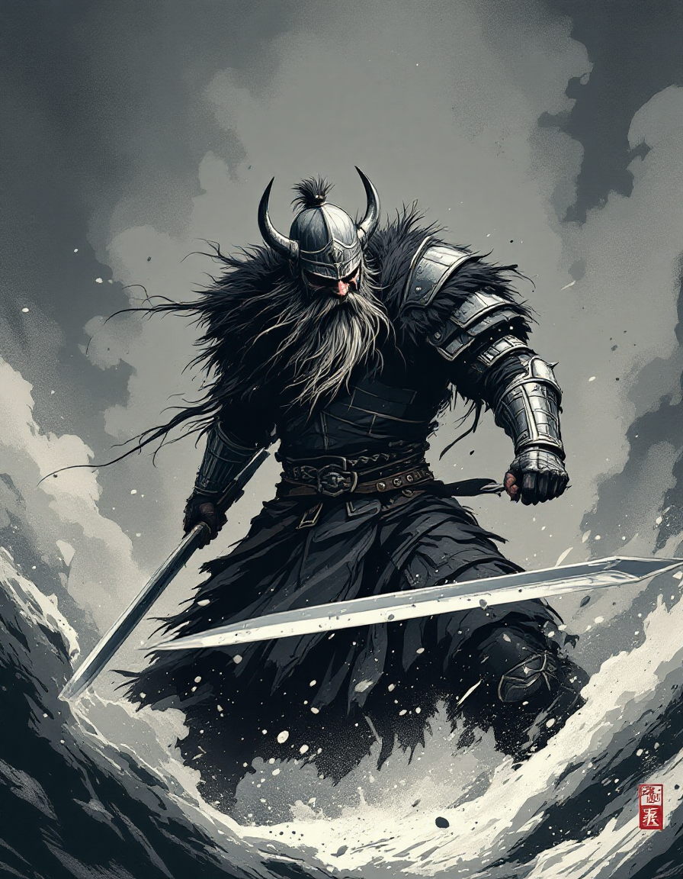
Creating the Viking Warrior
Inherited class from parent class soldier.
Takes 3 parameters: 2 from parent class (health,strength) and an independent parameter name.
Includes 2 methods: battleCry and recieveDamage.
battleCry returns a rallying cry and a challenge. "Odin Owns You All!
recieveDamage() takes the parameter damage as an input.
Calculates the new health of the viking army according to damage taken.
Damage is equal strength attribute of the saxon army.
class Viking(Soldier):
def __init__(self, name, health, strength):
super().__init__(health, strength)
self.name = name
def battleCry(self):
return “Odin Owns You All!"
def receiveDamage(self, damage):
self.health = self.health - damage
if self.health > 0:
return f"{self.name} has received {damage} points of damage"
else:
return f"{self.name} has died in act of combat"

Slide 5
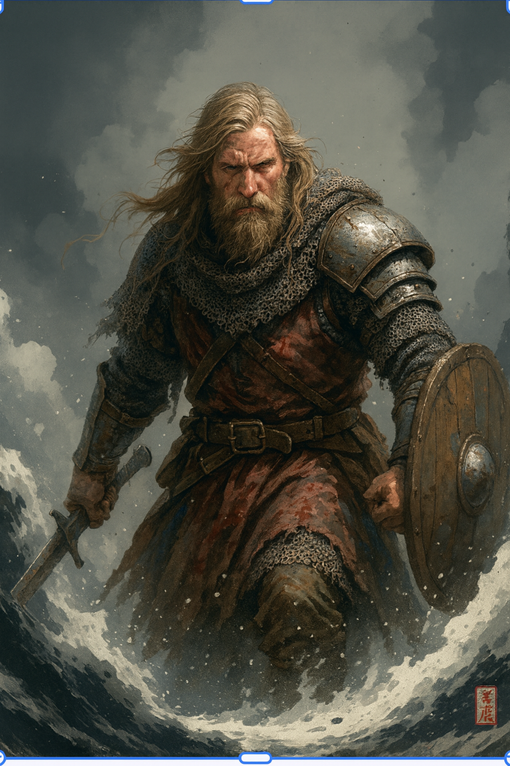
Building the Saxon warriors
class Saxon(Soldier):
def __init__(self, health, strength):
super().__init__(health, strength)
def receiveDamage(self, damage):
self.health = self.health - damage
if self.health > 0:
return f"A Saxon has received {damage} points of damage"
else:
return f"A Saxon has died in combat"

Slide 6
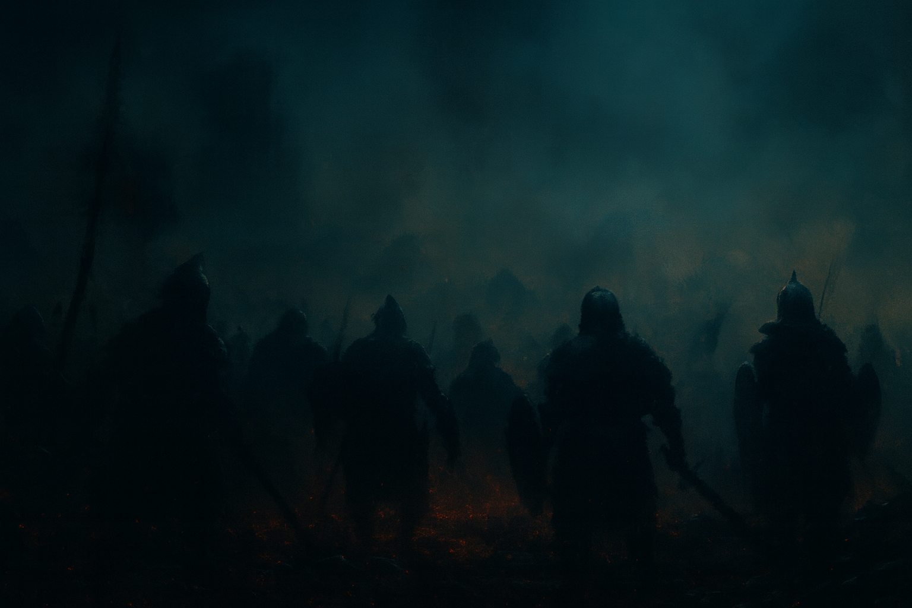
Class War Structure
Used Attributes:
vikingArmy: this is a list, that stores the Vikings in war
saxonArmy: lists all the Saxons
Main Responsibilities:
Manages Both Armies: The War class holds and organizes both Viking and Saxon armies so that battles can be run fairly and efficiently.
Add Fighters:
  addViking(viking): Adds a Viking object to the Viking army list.
  addSaxon(saxon): Adds a Saxon object to the Saxon army list.
Battle Logic:
  vikingAttack(): Randomly selects a Viking and a Saxon. The Viking attacks, and the Saxon receives damage. If a Saxon's health reaches zero or below, they are removed from the army. Returns a message about the attack result.
  saxonAttack(): The Saxon attacks a Viking using the same logic, removing dead Vikings.
Keep the War Status Updated:
  showStatus(): Checks the armies and returns a message:
    If the Saxon army is empty, Vikings have won.
    If the Viking army is empty, Saxons survive another day.
    If both armies have fighters, the battle continues.
class War():
def __init__(self):
# your code here
self.vikingArmy = []
self.saxonArmy = []
def addViking(self, viking):
# your code here
#self.viking = viking
self.vikingArmy.append(viking) #1.vikingarmy = [4,2,5,2]
#1.saxonarmy = []
def addSaxon(self, saxon):
# your code here
self.saxonArmy.append(saxon)
class War():
def __init__(self):
# your code here
self.vikingArmy = []
self.saxonArmy = []
def addViking(self, viking):
# your code here
#self.viking = viking
self.vikingArmy.append(viking) #1.vikingarmy = [4,2,5,2]
#1.saxonarmy = []
def addSaxon(self, saxon):
# your code here
self.saxonArmy.append(saxon)

Slide 7




Victory Conditions
Vikings Win
When saxon Army is empty: Vikings have won the war of the century!
Saxons Survive
When viking Army is empty: Saxons have fought for their lives and survive another day:
Battle Continues
When both armies have warriors: Vikings and Saxons are still in the thick of battle.

Slide 8
Thank you for your attention!

